Slide 1

HARSH GOTECHA
MENTORNESS

Slide 2
Schema of corona Data
CREATE TABLE CovidData
(Province VARCHAR(255), Country VARCHAR(255), Latitude DECIMAL(9,6), Longitude DECIMAL(9,6), Date1 DATE, Confirmed INT, Deaths INT, Recovered INT );

Slide 3
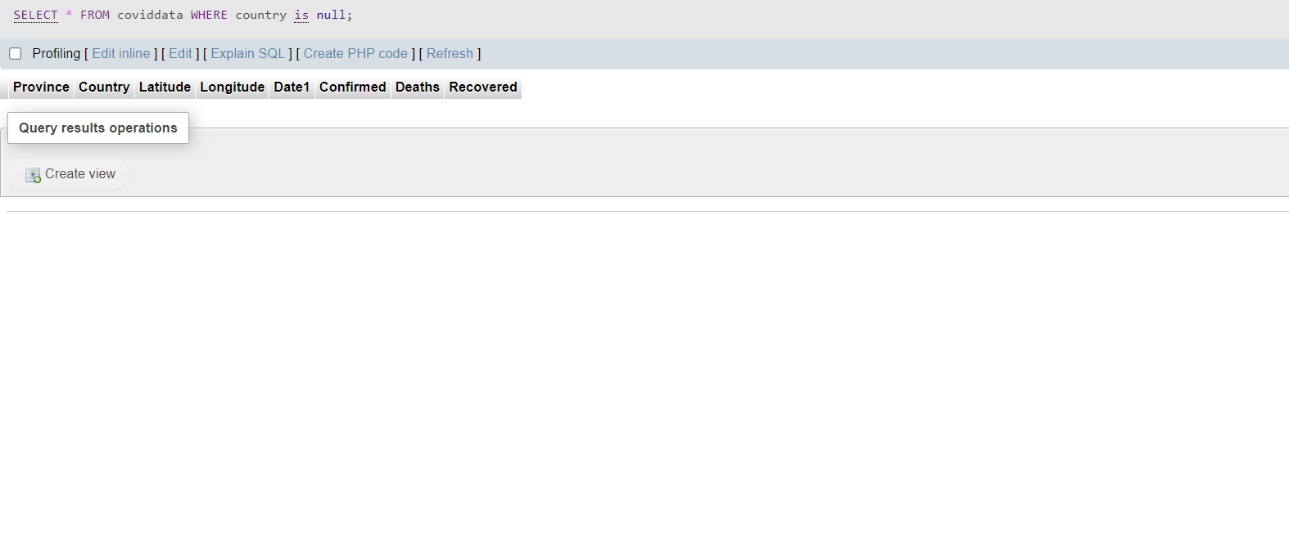
Write a code to check NULL values
SELECT * FROM coviddata
WHERE country is null

Slide 4
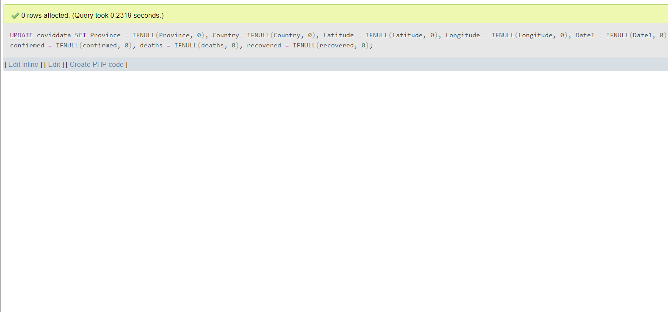
2. If NULL values are present, update them with zeros for all columns.
UPDATE coviddata
SET Province = IFNULL(Province, 0), Country= IFNULL(Country, 0), Latitude = IFNULL(Latitude, 0), Longitude = IFNULL(Longitude, 0), Date1 = IFNULL(Date1, 0), confirmed = IFNULL(confirmed, 0), deaths = IFNULL(deaths, 0), recovered = IFNULL(recovered, 0)

Slide 5
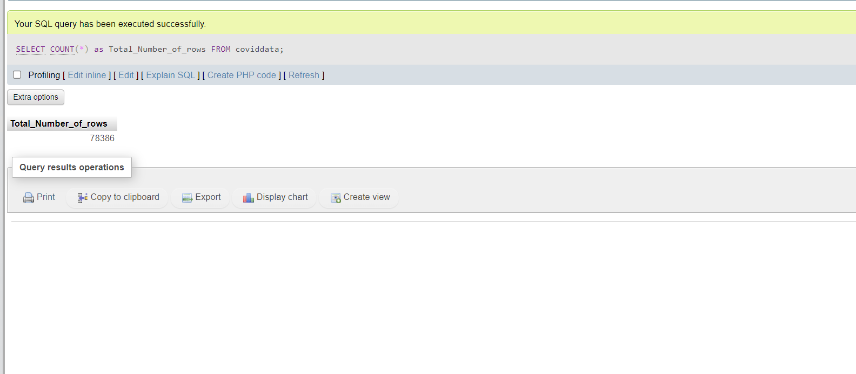
3. check total number of rows
SELECT COUNT(*) as Total_Number_of_rows
FROM coviddata

Slide 6
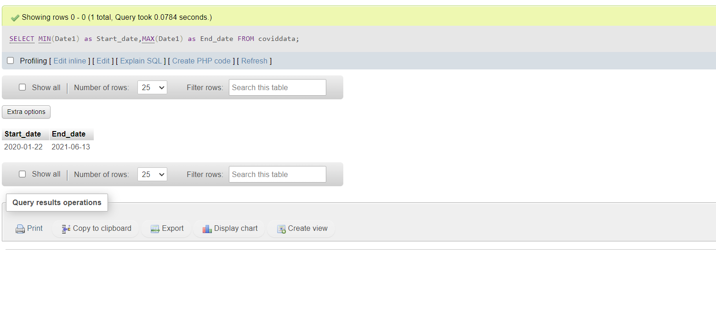
4. Check what is start_date and end_date
SELECT MIN(Date1) as Start_date,MAX(Date1) as End_date
FROM coviddata

Slide 7
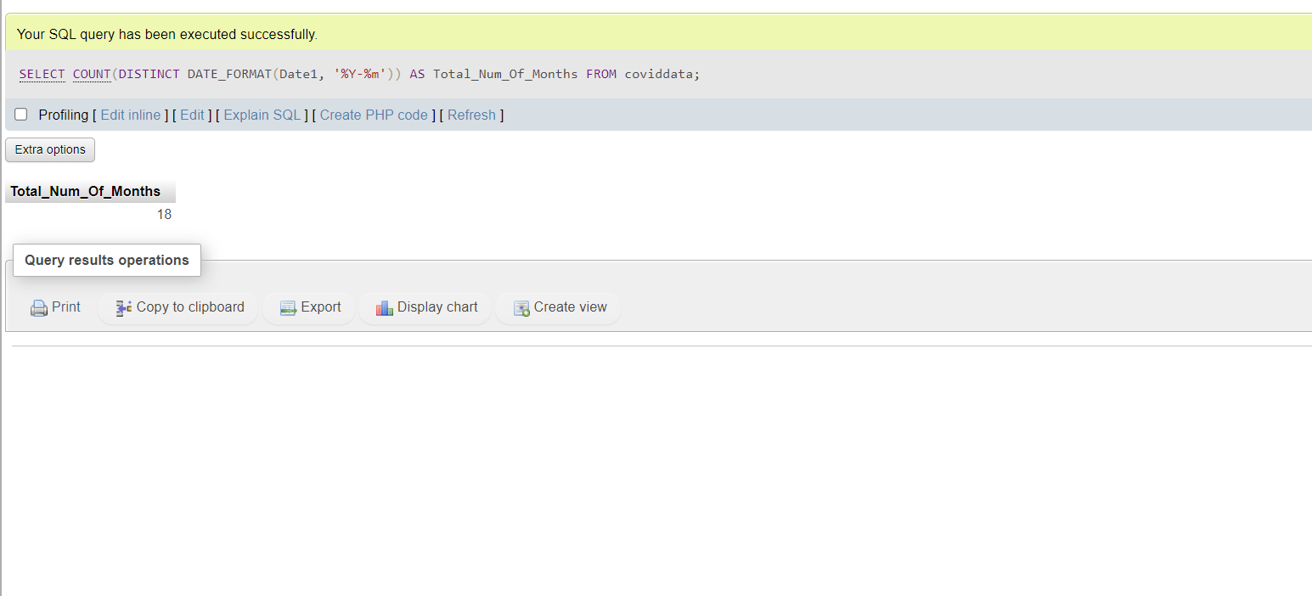
5. Number of month present in dataset
SELECT COUNT(DISTINCT DATE_FORMAT(Date1, '%Y-%m')) AS Total_Num_Of_Months
FROM coviddata

Slide 8
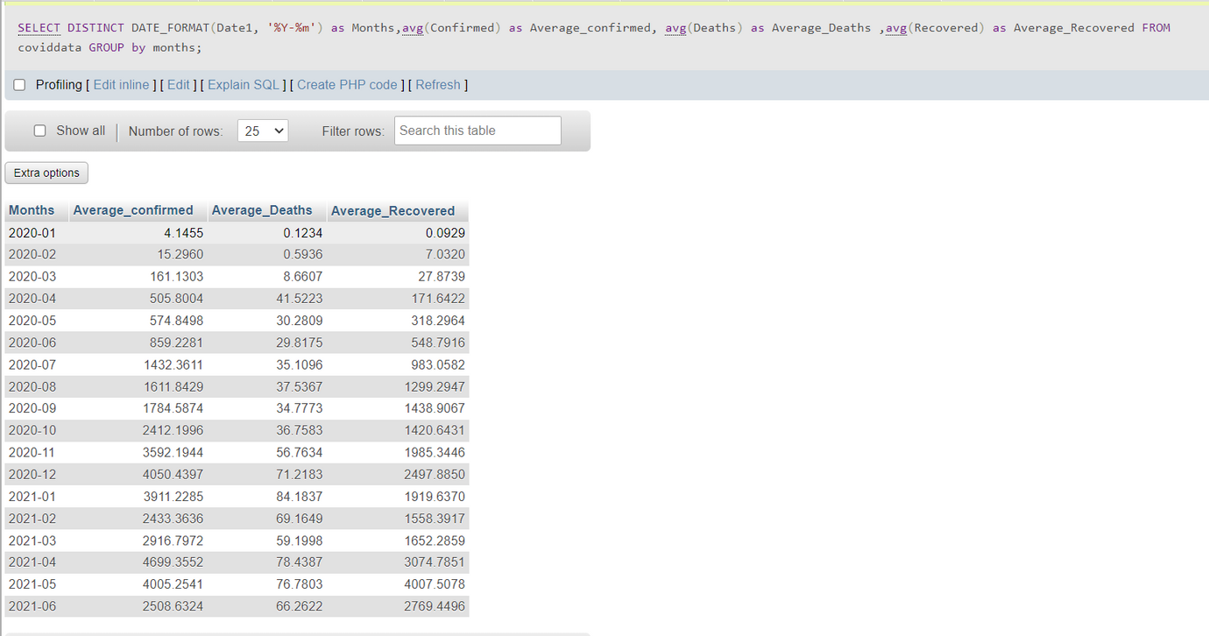
6. Find monthly average for confirmed, deaths, recovered
SELECT DISTINCT DATE_FORMAT(Date1, '%Y-%m') as Months, avg(Confirmed) as Average_confirmed, avg(Deaths) as Average_Deaths ,avg(Recovered) as Average_Recovered
FROM coviddata
GROUP by months

Slide 9
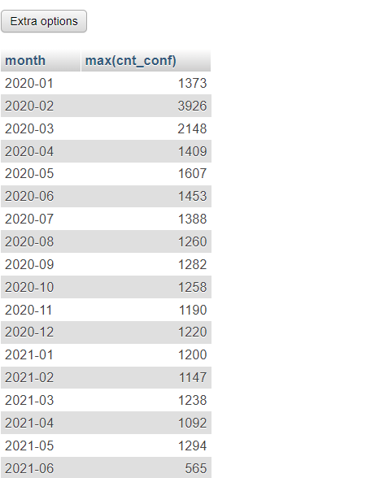
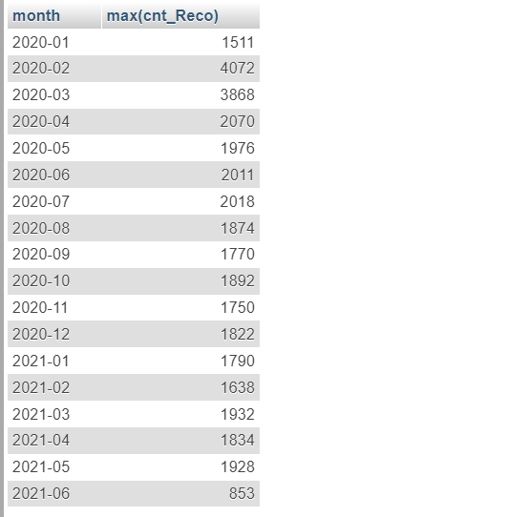
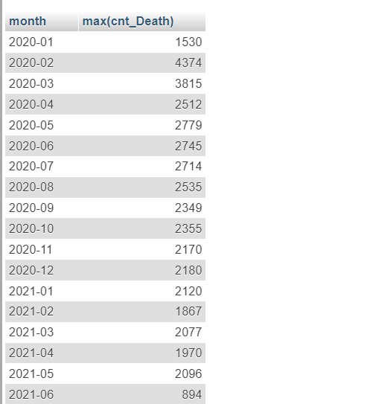
7. Find most frequent value for confirmed, deaths, recovered each month
With gg as (SELECT date_format(Date1,'%Y-%m') as month, Confirmed, count(Confirmed) as cnt_conf FROM coviddata
GROUP by month, confirmed)
Select month, max(cnt_conf)
FROM gg
Group by month;
With gg as (SELECT date_format(Date1,'%Y-%m') as month, Deaths, count(Deaths) as cnt_Death FROM coviddata
GROUP by month, Deaths)
Select month, max(cnt_Death)
FROM gg
Group by month;
With gg as (SELECT date_format(Date1,'%Y-%m') as month, Recovered, count(Recovered) as cnt_Reco FROM coviddata
GROUP by month, Recovered)
Select month, max(cnt_Reco)
FROM gg
Group by month;

Slide 10
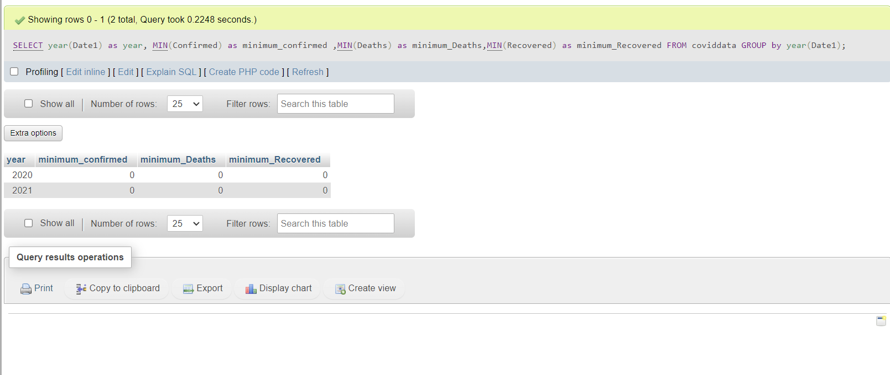
8. Find minimum values for confirmed, deaths, recovered per year
SELECT year(Date1) as year, MIN(Confirmed) as minimum_confirmed ,MIN(Deaths) as minimum_Deaths,MIN(Recovered) as minimum_Recovered
FROM coviddata
GROUP by year(Date1)

Slide 11
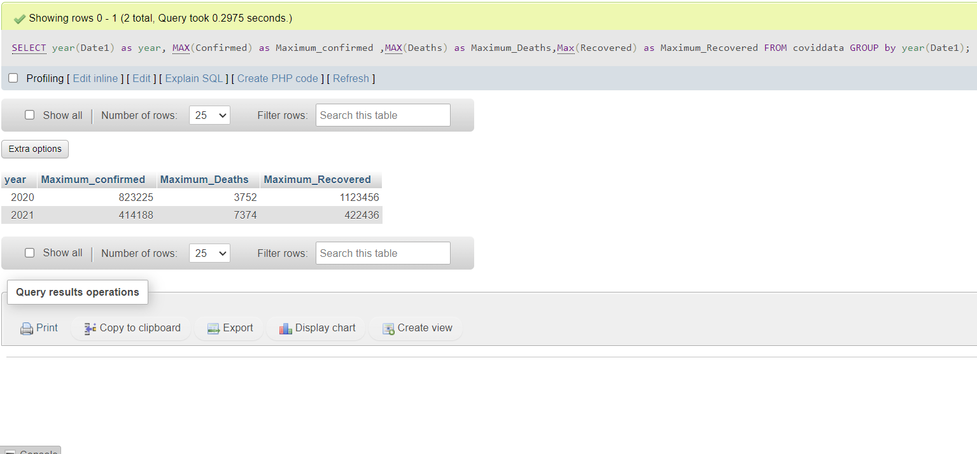
9. Find maximum values of confirmed, deaths, recovered per year
SELECT year(Date1) as year, MAX(Confirmed) as Maximum_confirmed ,MAX(Deaths) as Maximum_Deaths,Max(Recovered) as Maximum_Recovered
FROM coviddata
GROUP by year(Date1)

Slide 12
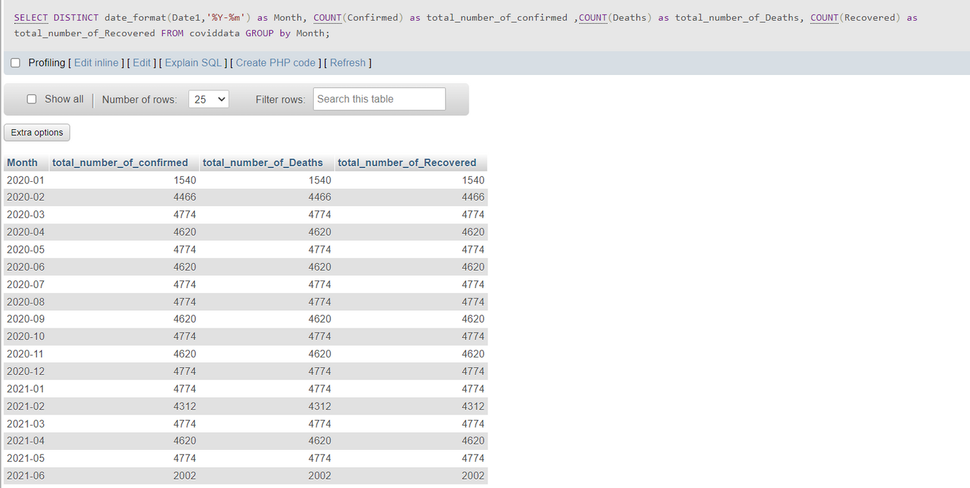
10. The total number of case of confirmed, deaths, recovered each month
SELECT DISTINCT date_format(Date1,'%Y-%m') as Month, COUNT(Confirmed) as total_number_of_confirmed ,COUNT(Deaths) as total_number_of_Deaths, COUNT(Recovered) as total_number_of_Recovered
FROM coviddata
GROUP by Month

Slide 13
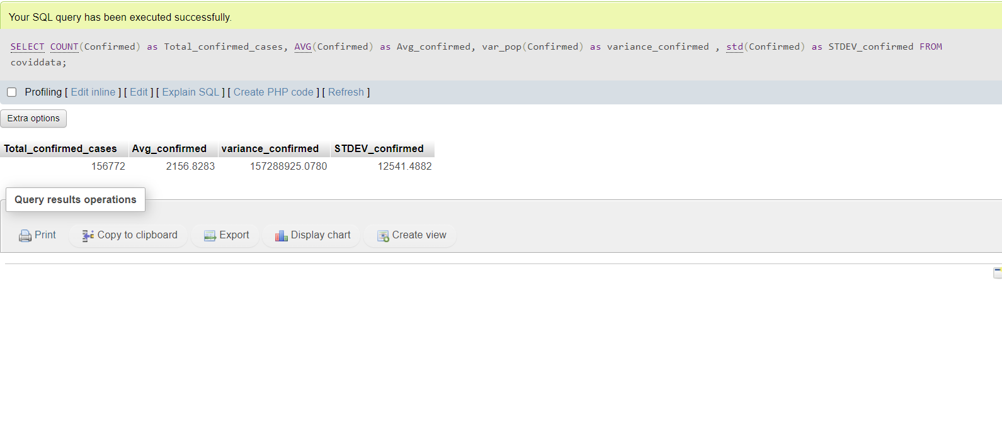
11. Check how corona virus spread out with respect to confirmed case
(Eg.: total confirmed cases, their average, variance & STDEV )
SELECT COUNT(Confirmed) as Total_confirmed_cases, AVG(Confirmed) as Avg_confirmed, var_pop(Confirmed) as variance_confirmed , std(Confirmed) as STDEV_confirmed
FROM coviddata

Slide 14
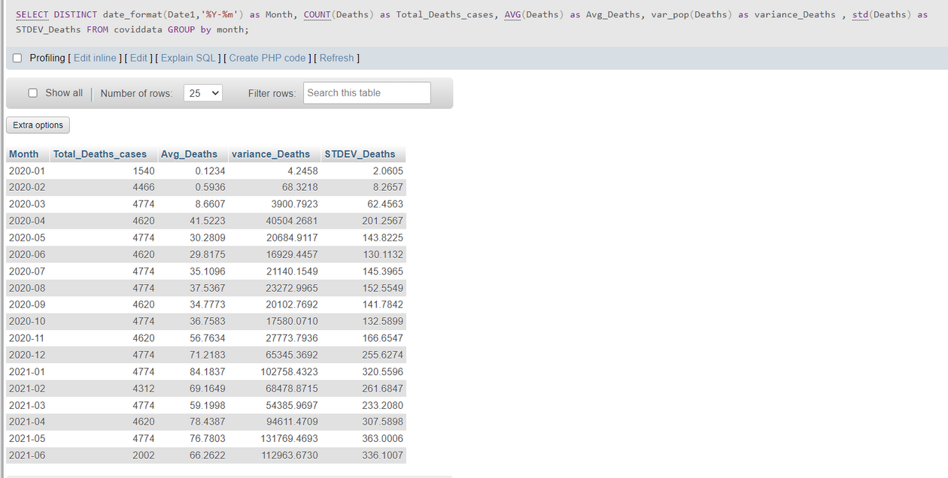
12. Check how corona virus spread out with respect to death case per month
-- (Eg.: total confirmed cases, their average, variance & STDEV )
SELECT DISTINCT date_format(Date1,'%Y-%m') as Month, COUNT(Deaths) as Total_Deaths_cases, AVG(Deaths) as Avg_Deaths, var_pop(Deaths) as variance_Deaths , std(Deaths) as STDEV_Deaths
FROM coviddata
GROUP by month

Slide 15
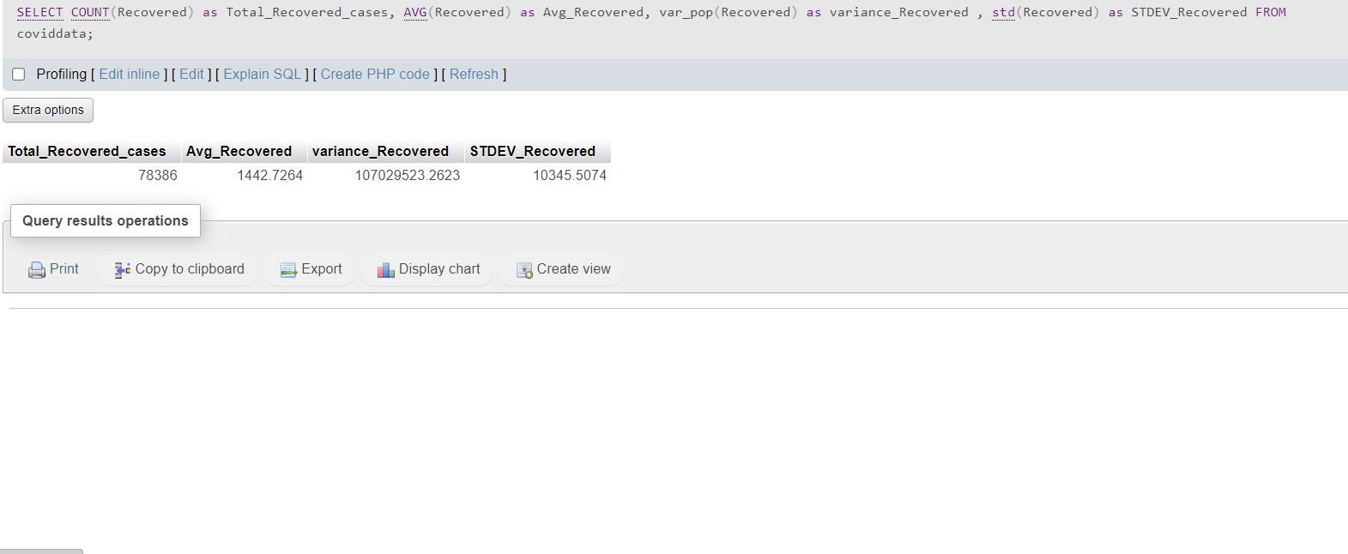
13. Check how corona virus spread out with respect to recovered case
-- (Eg.: total confirmed cases, their average, variance & STDEV )
SELECT COUNT(Recovered) as Total_Recovered_cases, AVG(Recovered) as Avg_Recovered, var_pop(Recovered) as variance_Recovered , std(Recovered) as STDEV_Recovered
FROM coviddata

Slide 16
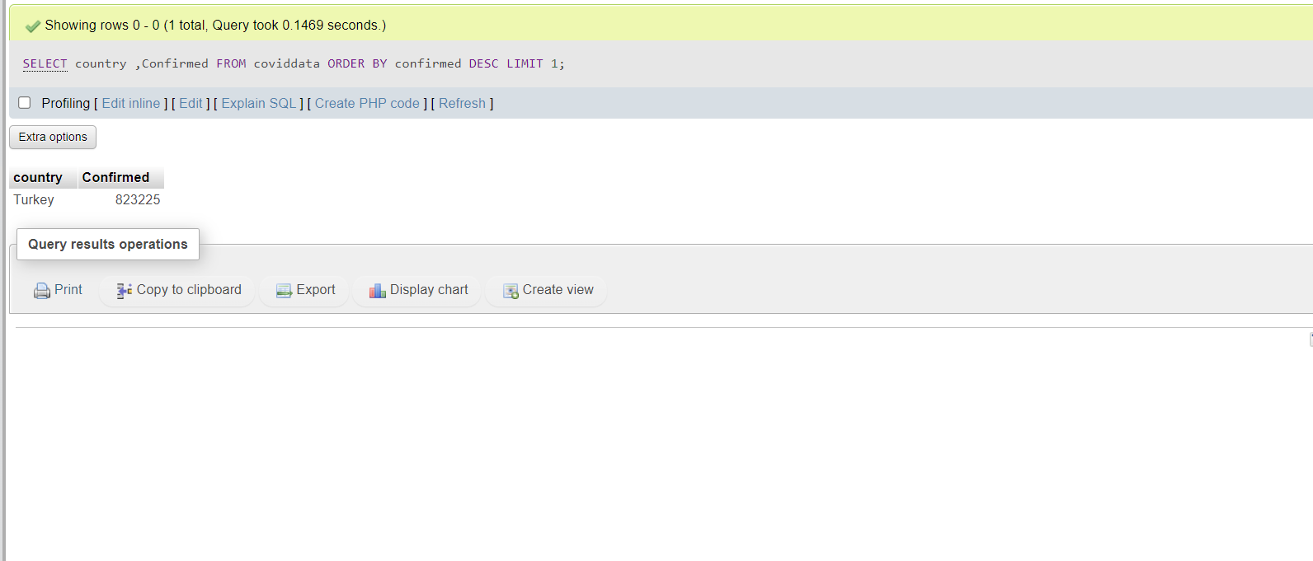
14. Find Country having highest number of the Confirmed case
SELECT country ,Confirmed
FROM coviddata
ORDER BY confirmed DESC
LIMIT 1;

Slide 17
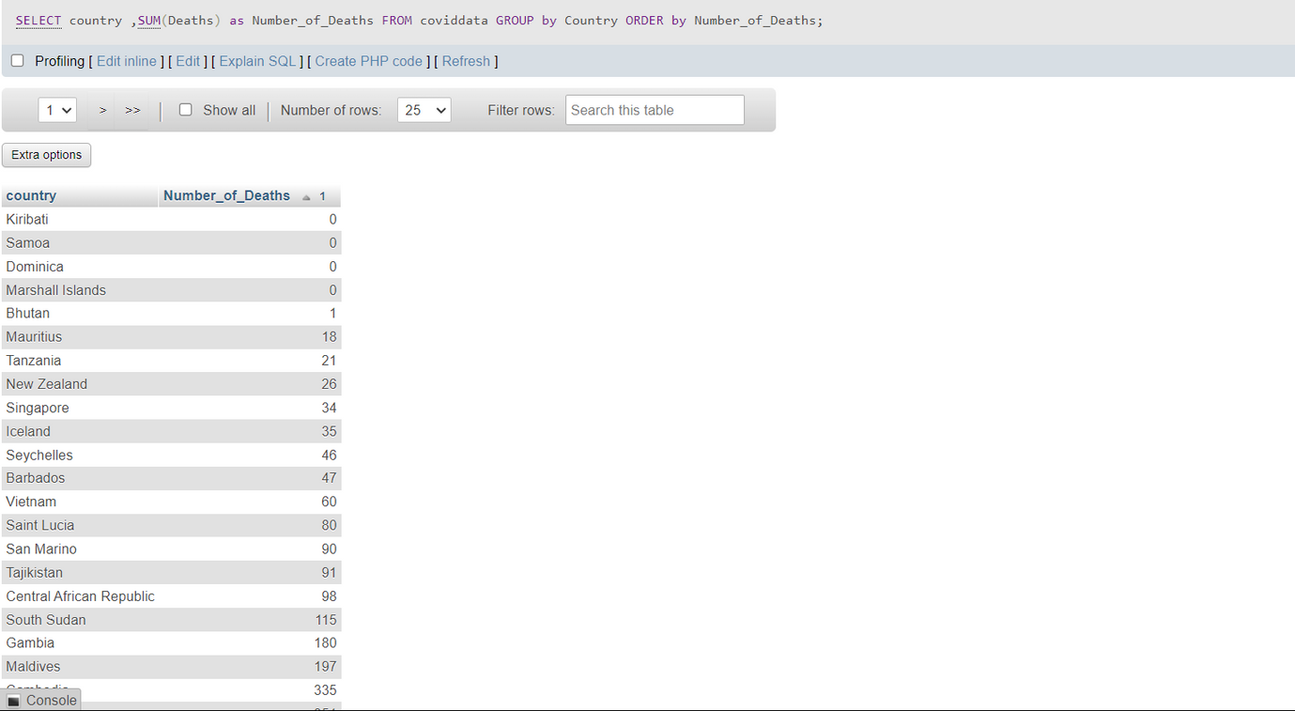
15. Find Country having lowest number of the death case
SELECT country ,SUM(Deaths) as Number_of_Deaths
FROM coviddata
GROUP by Country
ORDER by Number_of_Deaths

Slide 18
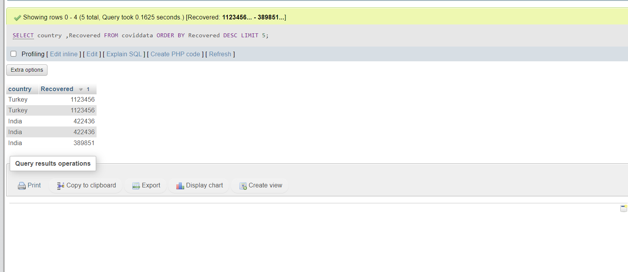
16. Find top 5 countries having highest recovered case
SELECT country ,Recovered
FROM coviddata
ORDER BY Recovered DESC
LIMIT 5;

Slide 19
THANK YOU

